Slide 1



NAAN MUDHALVAN
MERN stack powered by mongoDB

Slide 2
PROJECT ON SB FOODS-FOOD ORDERING APP
By Team Members Of Final Year IT 'B'
NAME REGISTER NUMBER
SYED SIDDIQ C 311421205095
SAMEERUDIN S 311421205303
GOWTHAM S 311421205301
VINOTH L 311421205304

Slide 3
ABSTRACT
-->SB Foods is an innovative web application designed to enhance the online food ordering experience by offering convenience, efficiency, and simplicity. This full-stack application, built using the MERN stack (MongoDB, Express.js, React.js, and Node.js), allows users to browse through a wide variety of dishes, place orders seamlessly, and enjoy food delivered right to their doorstep.
-->The app addresses the needs of modern foodies, ensuring that they can access detailed dish information such as descriptions, pricing, customer reviews, and promotions with ease. Users can personalize their orders, select payment methods, and get real-time updates on delivery status. Designed to serve even during late-night cravings, the platform simplifies the process of ordering, making it possible for users like college students or late-night workers to enjoy delicious meals without hassle.

Slide 4
APPLICATION ARCHITECTURE
The application architecture is divided into three key layers:
Frontend: The user interface (UI) incorporates features such as user authentication, shopping cart management, product browsing, and profile management. The design ensures a smooth and intuitive experience for users across devices.
Backend: The server-side includes well-defined API endpoints for handling user management, order processing, product catalogs, and admin functionalities, including authentication and dashboard control.
Database: The database stores essential data, including user profiles, orders, products, and cart details, utilizing MongoDB collections to ensure scalability and efficiency.

Slide 5
PURPOSE
The purpose of the SB Foods app is to provide a seamless, efficient, and user-friendly platform for online food ordering that caters to users' diverse needs and schedules. It addresses key challenges faced by modern consumers, such as time constraints, convenience, and accessibility.
Here’s a breakdown of its primary goals:
1. Enhance User Convenience
Offer an intuitive and streamlined food ordering process.
Provide detailed information about dishes, including descriptions, reviews, and pricing.
Enable easy browsing through a wide range of menus and cuisines.

Slide 6
2. Accessibility for All Scenarios
Be available for users anytime, including unconventional hours like late nights (e.g., Lisa’s scenario).
Offer features like real-time availability of restaurants and delivery services to ensure users can satisfy cravings on demand.
3. Decision-Making Support
Include reviews, ratings, and promotions to help users make informed food choices.
Minimize uncertainty about orders by providing clear details and accurate delivery times.
.

Slide 7

4. Efficiency in Ordering and Delivery
Reduce friction in the ordering process with features like cart management, payment integration, and order tracking.
Enable instant order confirmation and accurate delivery time estimations to reassure users.
5. Enhanced User Experience (UX)
Maintain a responsive, visually appealing interface for devices of all sizes

Slide 8
SCOPE
User-Centric Food Ordering Experience:
-->Provide seamless account management, menu browsing, and order placement.
-->Offer personalized recommendations and easy reordering options.
Efficient Admin and Restaurant Management:
-->Enable restaurants to manage menus, pricing, and orders.
-->Include an admin dashboard for overseeing users, orde/rs, and promotions.
Real-Time Order Tracking and Notifications:
-->Allow users to track delivery status in real time.
--.Send notifications for order updates, promotions, and delivery times.
Scalable and Secure Technical Infrastructure:
-->Use MERN stack for efficient and secure app development9
-->Ensure the app can handle growing traffic and future feature additions.

Slide 9

SYSTEM REQUIRMENTS:
HARDWARE :
-->Operating System : Windows 8 or higher
-->RAM : 4GB or more (8GB recommended for smooth development experience)
SOFTWARE :
-->Node.js : LTS version for back-end and front-end development
-->MongoDB : For database management using MongoDB Atlas or a local instance
-->React : For front-end framework
-->Express.js : For back-end framework
-->Git : Version control
-->Code Editor : e.g., Visual Studio Code

Slide 10

PRE-REQUISITES :
VITE+RREACT
Vite + React is a new frontend build tool that aims to improve the developer experience for development with the local machine, and for the build of optimized assets for production (go live). Vite (or ViteJS) includes: a development server with ES _native_ support and Hot Module Replacement; a build command based on rollup.
Installation : npm create vite@latest

Slide 11

Node.js
• Node.js is a powerful JavaScript runtime environment that allows you to run JavaScript code on the server-side. Install Node.js and npm on your development machine, as they are required to run JavaScript on the server-side.
• Download: https://nodejs.org/en/download/
• Installation instructions: https://nodejs.org/en/download/package- manager/
• Run “npm init” to get default dependencies

Slide 12

Express.js is a fast and minimalist web application framework for Node.js. It simplifies the process of creating robust APIs and web applications, offering features like routing, middleware support, and modular architecture. It handles server-side routing, middleware, and API development. • Installation: Open your command prompt or terminal to run the following command: npm install express

Slide 13

Mongo DB
MongoDB is a flexible and scalable NoSQL database that stores data in a JSON-like format. It provides high performance, horizontal scalability, and seamless integration with Node.js, making it ideal for handling large amounts of structured and unstructured data.
• Download: https://www.mongodb.com/try/download/community
• Installation instructions: https://docs.mongodb.com/manual/installation/

Slide 14
Use Case - Late-Night Craving Resolution
Scenario: Late-Night Craving Resolution:
¢Meet Lisa, a college student burning the midnight oil.
¢She skipped dinner and wants a quick, convenient solution to satisfy her hunger.
¢Solution: SB Foods allows Lisa to order food seamlessly during late-night hours.
¢Steps Lisa Takes:
¢Navigates to late-night delivery options.
¢Selects her favorite diner and dishes.
¢Adds the items to her cart, specifies delivery address, and chooses payment method.
¢Receives instant confirmation and order tracking.

Slide 15
User Journey - From Cravings to Satisfaction
USER JOURNEY - Lisa's Late-Night Order
1.Explore: Lisa browses through late-night food options.
2.Select & Add to Cart: Chooses comfort food (chicken noodle soup + garlic bread).
3.Checkout: Reviews order, enters address and payment info.
4.Order Confirmation: Receives notification with estimated delivery time.
5.Delivery: Food arrives on time, allowing Lisa to focus on her assignment.

Slide 16
Admin Dashboard Features
FEATURES:
Order Management: View and update orders in real-time.
Product Management: Add, update, or remove menu items.
User Management: View and manage user accounts.
Analytics: Track popular products, orders, and revenue.

Slide 17

How SB Foods Solves Problems
Convenience: No need to cook or go outside during late hours.
Quick Ordering Process: Seamless checkout in just a few taps.
Real-Time Notifications: Order tracking and timely delivery updates.
24/7 Availability: Late-night delivery options are clearly highlighted.

Slide 18
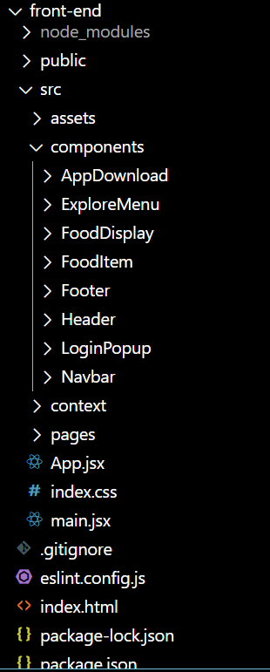
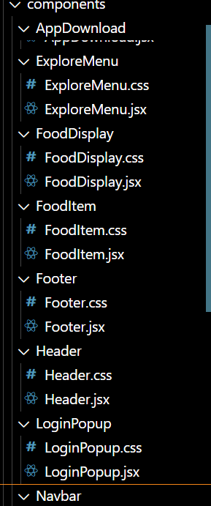
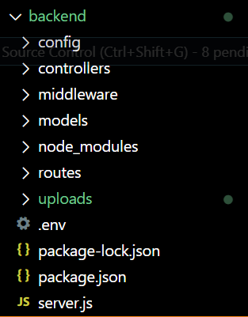
PROJECT STRUCTURE :

Slide 19
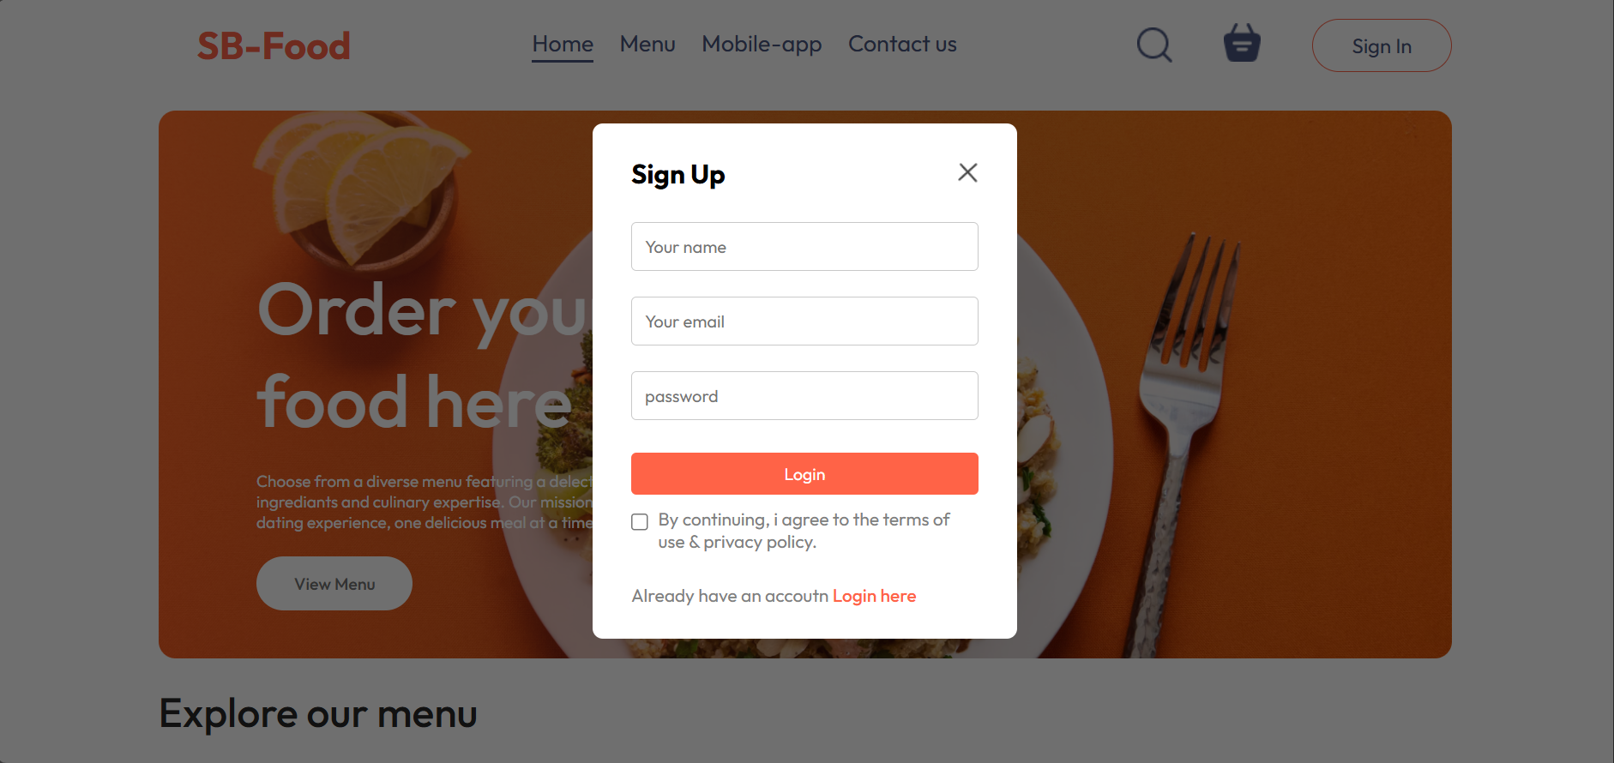
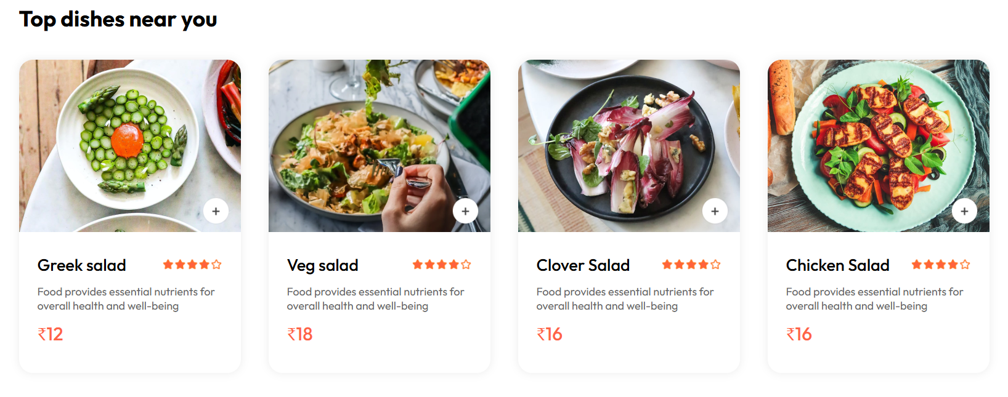
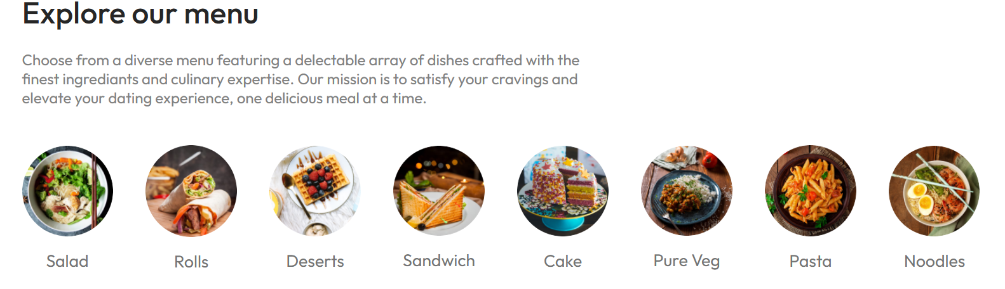
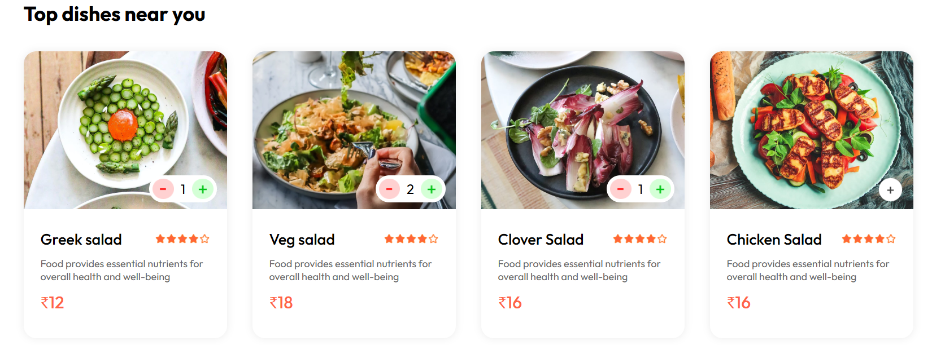
PROJECT EXECUTION SCREENSHOTS:

Slide 20
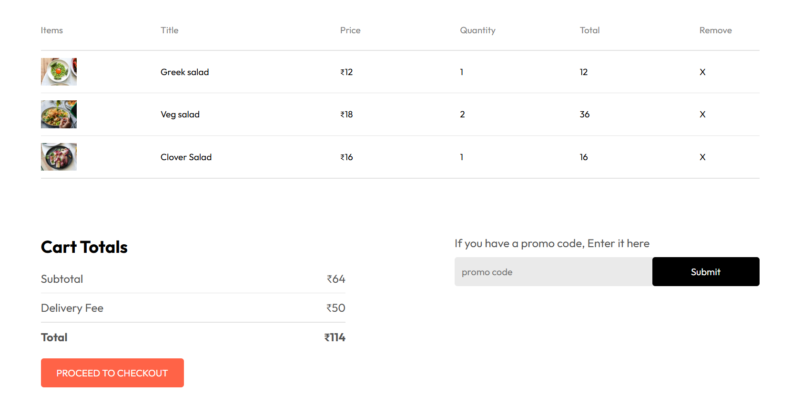
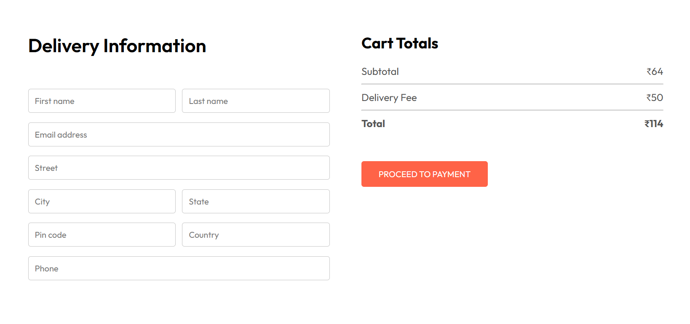
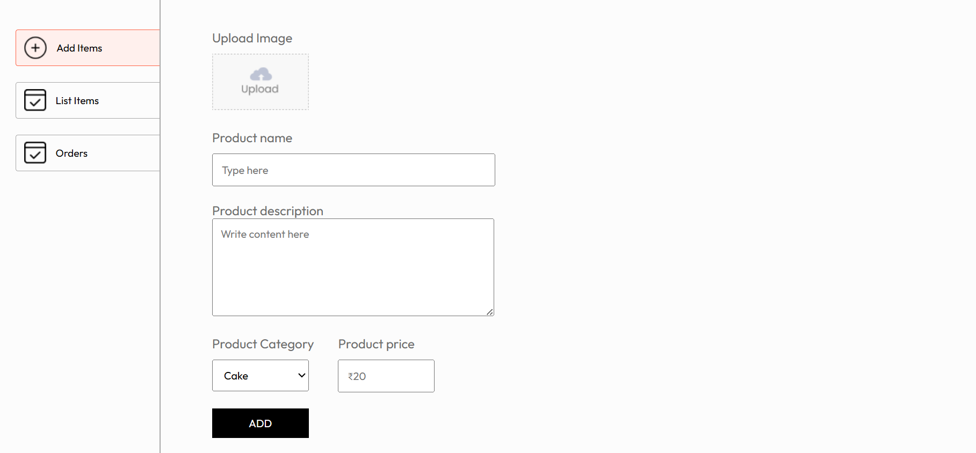
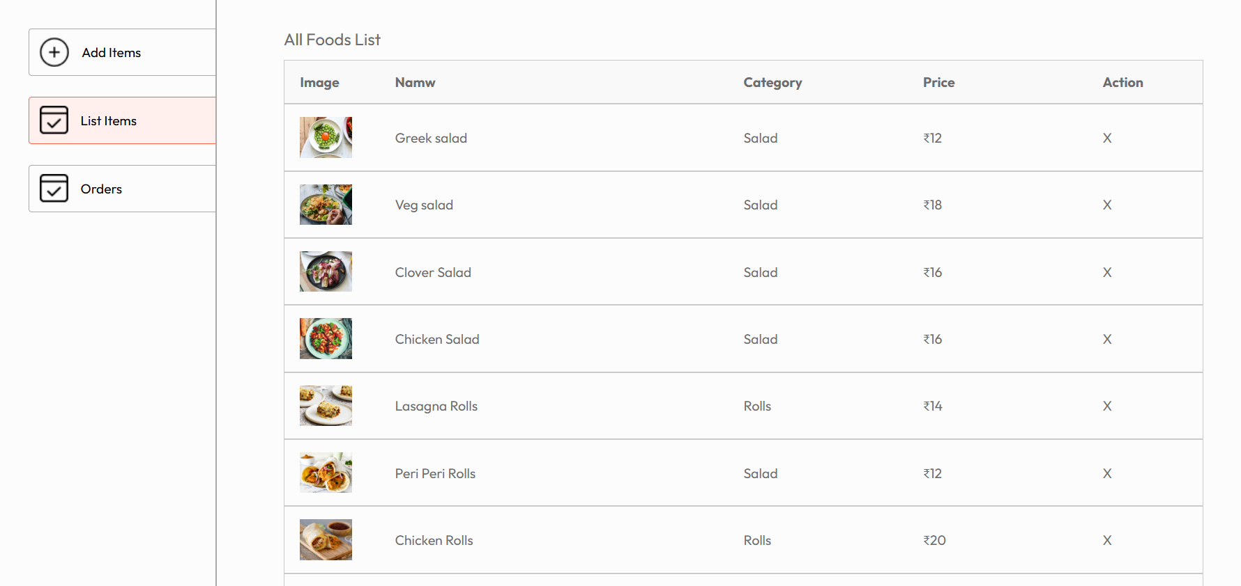

Slide 21
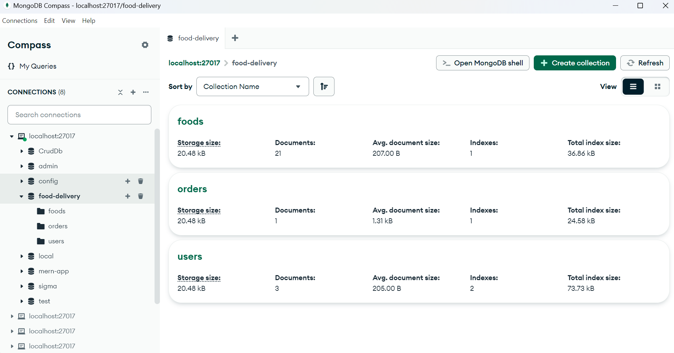
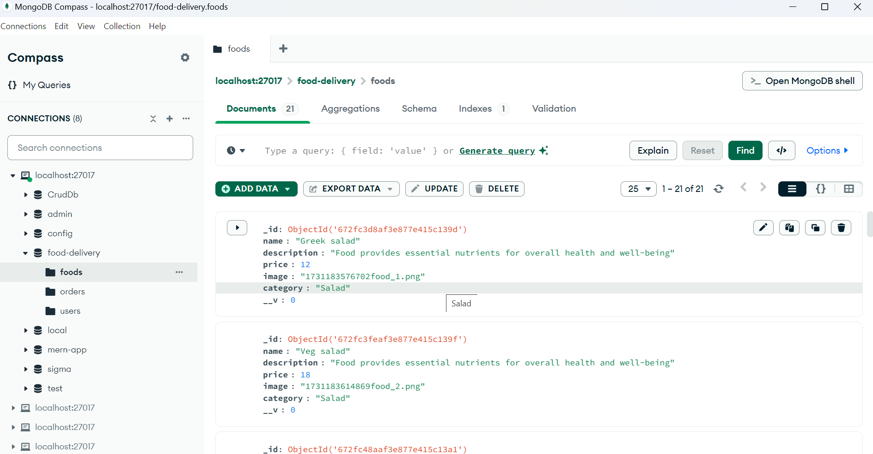
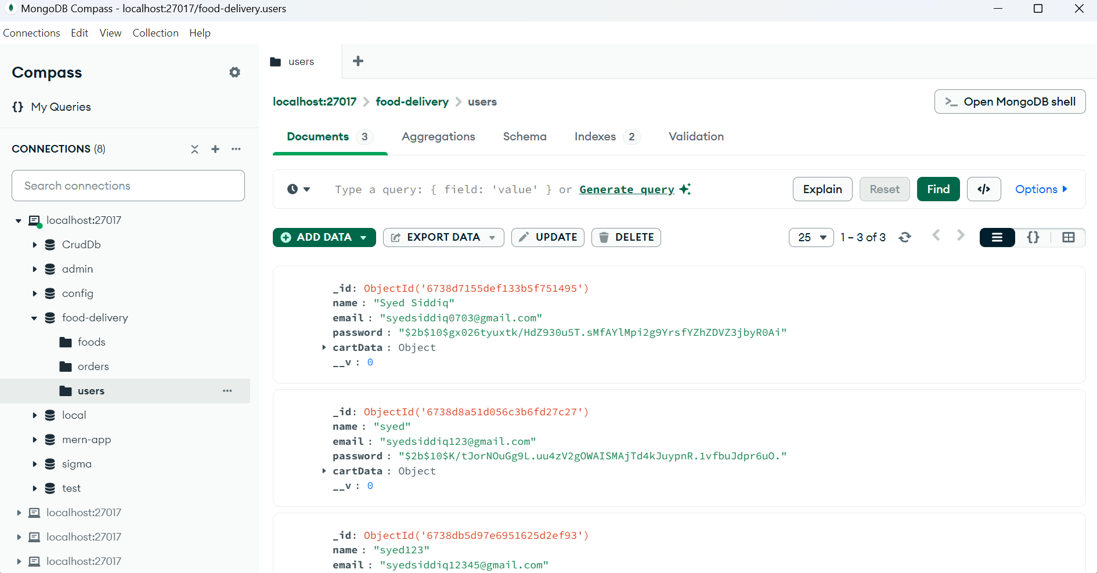
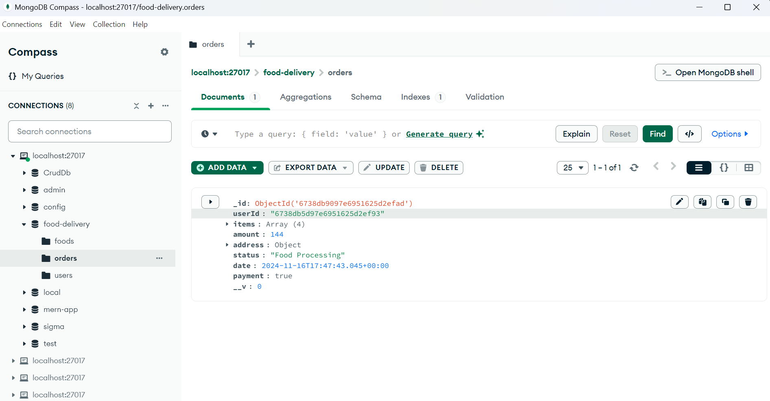

Slide 22
CONCLUSION
The SB Foods app is a comprehensive solution designed to modernize and simplify the food-ordering process. By combining user-centric design, seamless functionality, and a scalable technical foundation, it caters to the diverse needs of both customers and restaurant operators.
SB Foods not only addresses the immediate needs of food enthusiasts by offering convenience and variety but also establishes a strong foundation for future growth and innovation. It bridges the gap between users and restaurants, ensuring quality service and satisfaction at every step. With its focus on efficiency, accessibility, and customer satisfaction, SB Foods is poised to become a leader in the food-ordering ecosystem.

Slide 23

THANK YOU

